Slide 1
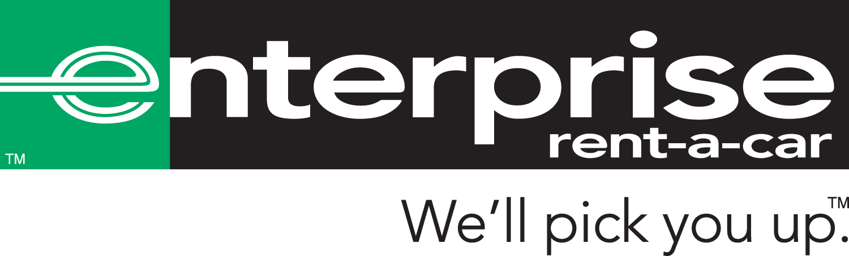
By:
Christine Urban
Yulia Burvan
Anthony Connor
Karina Makarova

Slide 2

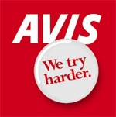

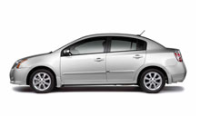

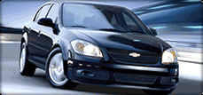
The Price is Right…
Pick- Up: Nov 25, 2010 (Thanksgiving) Drop Off: Nov 26, 2010
Out of the Atlantic City area
Intermediate 2 or 4 dr., ICAR , Nissan Sentra or similar
Chevrolet Cobalt or similar
Nissan Versa, Toyota Yaris or similar
2 or 4 doors
$ 84.99 USD Per Day
$ 58.11 USD Per Day
$ 54.35 USD Per Day

Slide 3

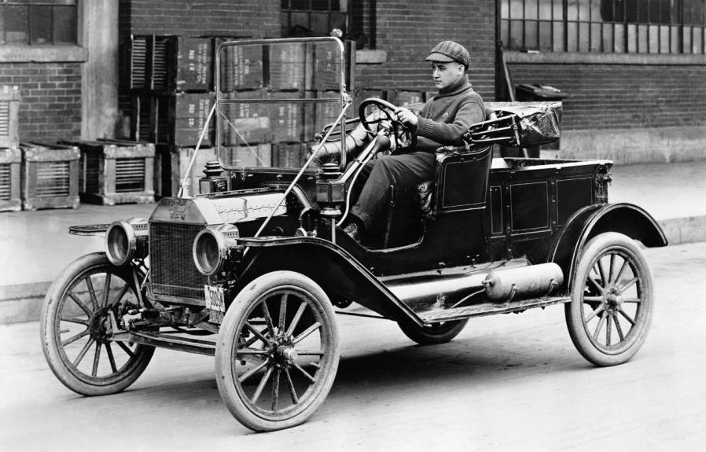
L king Back…
U.S. Automobile Rental Industry
*Can be attributed to two individuals: Joe Saunders and Walter T. Jacobs.
*In Omaha, Nebraska of 1916, Joe Saunders began renting a secondhand Model-T for 10 cents a mile.
*By 1925 Saunders had purchased over $1 million worth of automobiles from Chrysler and had operations in 21 states, however he wound up going bankrupt during the Great Depression in the early 1930’s.
*In 1918 Walter T. Jacobs started a small company in Chicago that bought, repaired, and rented Model-T autos.
*In five years his company was generating annual revenues of approximately $1 million which was then purchased by John Hertz, renamed it Hertz Drive-Ur-Self System and sold it to General Motors in 1926.
*In 1932, the first airport auto rental facility opened at Chicago’s Midway Airport by Hertz.
*WWII put many restrictions on auto rental industry which caused the market to stagnate, but after the war ended, it grew rapidly, expanding into the airline industry.
*1990’s- Off-Airport locations became more significant due to Enterprise.

Slide 4
L king Back…
*Enterprise was founded by Jack Taylor in 1957, and was originally named Executive Leasing Company based out of St. Louis, Missouri.
*The original location for this auto leasing company was the basement of a Cadillac dealership.
*This concept is still upheld today, because Enterprise strategically locates their offices in downtown locations in order to focus on their “off-airport” rentals.
*Taylor’s original business model was a simple concept that is still the backbone of Enterprise today: “Take care of your customers and employees first, and growth and profits will follow.”
*Over the next 50 years, the company was renamed Enterprise Rent-a-Car and grew to become the largest and most prosperous auto rental company in America, achieving approximately $9 billion from its multinational operations.
*Private Car rental business with a fleet of more than 878,000 rental and fleet service vehicles.
*Based in St Louis, Missouri with services in the U.S., Canada, Germany, Ireland, Puerto Rico and the U.K.

Slide 5
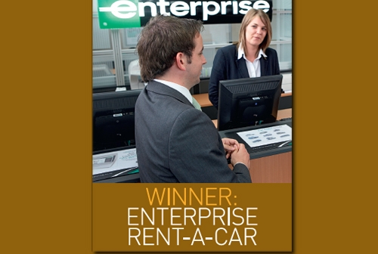
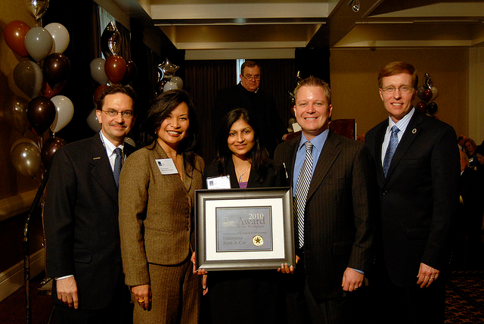
Accomplishments
* Enterprise is the largest car rental company in North America and ranked 49th on the list of “Most respected Companies in the US” in June 2008
*Enterprise Rent-A-Car customer service has been recognized seven times by J.D. Power and Associates as highest in customer satisfaction for rental car companies at or near airports.
*The company was named number 9 on Business Week's top 25 companies customer service list and as the 5th best company in which to start a career and as one of the 50 best employers in Canada.
*Enterprise is currently number 16 on the Forbes “500 Largest Private Companies in America” list.
*They offer customers one of the industry’s most diverse inventories and have been awarded a 97% customer satisfaction rating two years in a row.

Slide 6
Mission Statement
Our mission is to fulfill the automotive and commercial truck rental, leasing, car sales and related needs of our customers and, in doing so, exceed their expectations for service, quality and value.
We will strive to earn our customers' long-term loyalty by working to deliver more than promised, being honest and fair and "going the extra mile" to provide exceptional personalized service that creates a pleasing business experience.
We must motivate our employees to provide exceptional service to our customers by supporting their development, providing opportunities for personal growth and fairly compensating them for their successes and achievements.
We believe it is critical to our success to promote managers from within who will serve as examples of success for others to follow.
Although it is our goal to be the best and not necessarily the biggest or the most profitable, our success at satisfying customers and motivating employees will bring growth and long-term profitability.

Slide 7
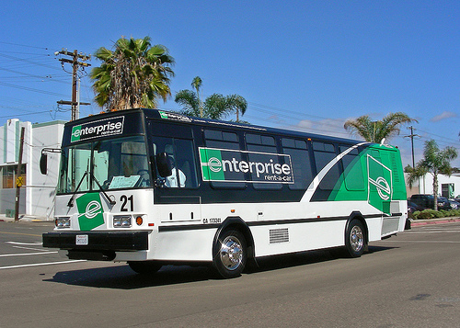

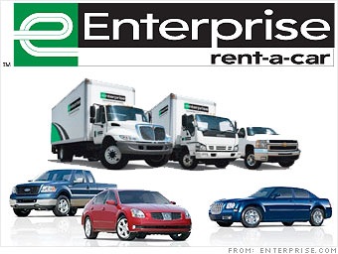
Breaking it Down
Enterprise is organized into six primary market segments:
Off-Airport Market- renting at neighborhood locations.
On-Airport Market-(1995) renting at airport locations.
After-Market Used Auto Sales- (1962) selling used cars to public instead of back to the manufacturer.
California Vanpool Services- (1994) providing carpool and vanpool services to individuals and companies in Northern and Southern CA.
Rent-a-Truck- (1999) serves businesses with replacement or supplemental transportation needs.
International Operations- (1993) expanded outside the U.S with first foreign office in Windsor, Canada.

Slide 8
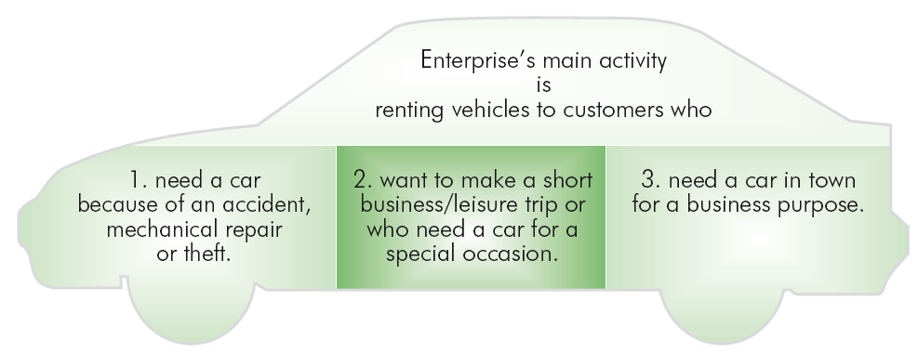
Marketing Mix
Product

Slide 9
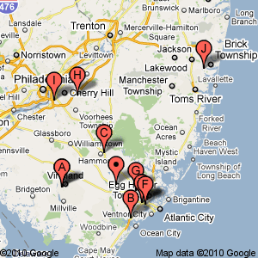
Marketing Mix
Place:
Enterprise’s branches are located in neighborhoods, where their customers live and work; in fact, there is an Enterprise branch within 15 miles of 90 percent of the U.S. population.
Price:
Although competitive, prices are generally more than its competitors, but the superior customer satisfaction makes it a worthwhile.
Promotion:
Superior Customer Relations Management and word-of-mouth marketing is the major way of marketing the Enterprise brand. Online and TV advertisements are also part of their promotion.

Slide 10
SWOT Analysis
STRENGTHS | WEAKNESES
Leading Market Position Robust Financial Performance No. 1 in Customer Service Large Fleet of Vehicles | Maintenance and Cost of Repairs Very Capital Intensive Operations No One-Way Rentals
OPPORTUNITIES | THREATS
Trend for renting Cars Use of Internet for Rentals Bigger presence at the Airports Serving ‘Green’ Customers | Increasing Fuel Prices Intense Competition (Hertz, Avis, National, Alamo, Dollar/ Thrifty Car Rentals) Downturn in the (Used) Car Markets Mergers & Acquisitions

Slide 11
“The Big Idea” Clip

Slide 12
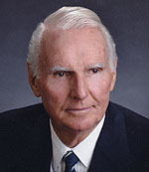

Customer Relations
Jack Taylor’s Business Philosophy:
“Take care of your customers and your employees, and profit will take care of itself.”
“Treat customers the way you would want to be treated as a customer. “
“Repeat customers are the quickest way to build a solid base of business.”
“Never promise what you can’t deliver; deliver more than you promise.”
“After dealing with us, we want customers to say, ‘This is the best place I’ve ever done business.’”

Slide 13
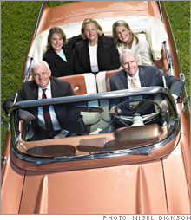
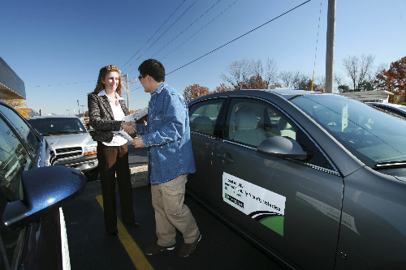
Customer Relations
*When Enterprise first started, Jack Taylor really wanted to know his customers personally. He would keep track of who was using their cars he could call and thank them. He started the business because he thought he could provide customers with the best possible experience.
*As they grew, Enterprise began to have some minor complaints so, in 1994, they decided to ramp up their customer satisfaction research.
*They created a measurement called ESQi (Enterprise Service Quality index) which is a statistically valid sample of customers' opinions taken monthly, at every one of their branches.
*There are two important questions asked. The first asks about the customer's satisfaction level, with five answers ranging from "completely satisfied" to "completely dissatisfied," and the second asks how likely he would be to return to Enterprise.

Slide 14
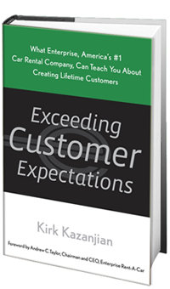
ESQi and Other Tactics
The ESQi results have helped to teach Enterprise what drives customer
satisfaction:
*the attitude and helpfulness of Enterprise employees
*the speed of the transaction
*the cleanliness of the car.
*Enterprise’s "We’ll Pick You Up" service, spares customers the hassle of getting a cab to
the rental office, and is its most visible customer service effort.
*They have developed a ‘Cycle of Service’ training program which gives new employees a
number of practical tips about how to take care of customers.
* Another way in which Enterprise has improved customer service is through a system of
constructive criticism known as ‘The Vote’. Each week members of a branch are asked to
rank others, from best to worst, based on the quality of their customer service in the
Previous week and to explain why. Awards are given to top-rated employees.
*This system of positive criticism works well and very quickly branches with low ESQi scores
improve in the performance tables.

Slide 15
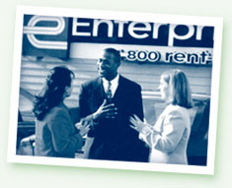
Financially Speaking
As a privately owned company, Enterprise restricts access to its detailed financial information, however…
Enterprise was eventually able to prove from their survey data that “completely satisfied” customers were three times more likely to rent a car again than those who were only "somewhat" satisfied and because of their superior customer service:
They went from being a nearly $2 billion business in 1994 to a $7 billion plus business today.

Slide 16
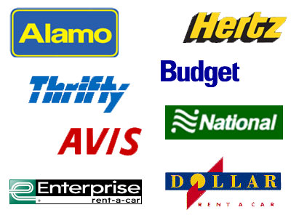
Standing Out
Enterprise’s two main competitors are: Hertz and Avis
Enterprise's true equity market value is estimated to be in the neighborhood of $17 billion, while Hertz is estimated at $7.5 Billion.
Enterprise is superior to both in more than dollars – they are not nearly as cyclical (because they have very little exposure to the volatilities of air travel), much less leveraged, and sounder all around.

Slide 17
Standing Out
Unlike airport-based rental car companies who may never see a customer again,
Enterprise agents are highly aware that keeping local customers happy is vital to the
company’s bottom line.
The concept of picking up customers at their homes was a field innovation and
it is the one feature that most differentiates Enterprise from its competition.
Enterprise also offers the world's largest fleet of fuel- efficient cars, including more
than 440,000 vehicles that get better than 28 miles per gallon on the highway
which is far more than any of its rivals.

Slide 18
Recommendations
Our recommendations to Andy would be to continue on the path of further globalization.
In the process do not lose sight of the basic company principles and to remain true to the company culture.
Perhaps they can integrate a “one way” rental service like that of their competitors so customers can pick up a car in one location and return it in another. This would ensure that they stay up on their competition.
Also, taking the company public would generate more revenues from investors to help handle costs and expenses.
Enterprise’s journey started with an attempt to improve performance. In doing so it took the company back to its roots, to the ideas first put forward by Jack Taylor. This illustrates that Enterprise is not really a car rental business at all – it is a customer service business.

Slide 19
Trivia Game

Slide 20
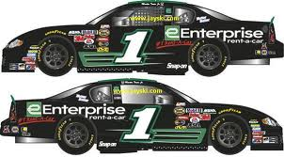
Enterprise and NASCAR
In September of 2005, Enterprise Rent-A-Car signed a multiyear deal with NASCAR to become the racing organization’s “official rental car company.”
Enterprise airs TV spots during NASCAR events and auto racing programming. Enterprise has also become a charter and exclusive rental car sponsor of the NASCAR RacePoints program, allowing race fans to earn points toward rewards when they rent vehicles from Enterprise.

