Slide 1
More Information than You Ever Wanted:
Does Facebook
Bring Out the Green-Eyed Monster of Jealousy?
Presented by: Anthony Connor
Amy Muise, M.Sc., Emily Christofides, M.Sc., and Serge Desmarais, Ph.D.
CYBERPSYCHOLOGY & BEHAVIOR
Volume 12, Number 4, 2009
ª Mary Ann Liebert, Inc.
DOI: 10.1089=cpb.2008.0263

Slide 2

Problem at Hand
Whether or not Facebook is causing stress and jealousy in romantic and sexual relationships.
Does the amount of time spent on Facebook determine how jealous a person becomes?

Slide 3
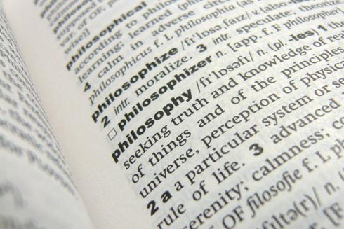
Defining Jealousy
Naturally prone to jealousy
  Genetics
  Emotional Stability
Individual Factors
  Level of trust
  Self-esteem
  Commitment in relationships

Slide 4
4 Categories of Jealousy Invoking Situations
Partner shows interest in another person
Another person shows interest in a persons partner
Partner communicates with an ex-partner
Partner involved in ambiguous situations

Slide 5

The Study
308 Person online survey
  231 Female
  77 Male
Undergraduate students
  17 – 24 years old (mean: 18.7)
21 survey questions
  Scale 1 (not likely) – 7 (very likely)
Open-ended Portion

Slide 6
33.6% Not involved in a relationship at all
50.5% Serious committed relationship
8.3% Casually dating one or more partners
3.7% Open relationship
3.0% Living with partner and unmarried
0.7% Married
0.3% Divorced/ Separated

Slide 7
The Results
Average 38.93 minutes spent online per day
Between 25 and 1000 added friends
  Mean = 296.19
74.6% Likely to add a previous partner
78.9% reported their partner added an ex-partner

Slide 8

Women spent significantly more time online than men.
Women were more naturally susceptible to jealousy than men.
46% of the variance contributed to Trait Jealousy

Slide 9
Qualitative Portion
Accessibility of information
  19.1% agreed that being able to obtain so much information so easily made them more jealous
Relationship Jealousy
  16.2% agreed that past relationship situations made them more jealous
Addiction Level
  10.3% agreed that addiction to Facebook was the reason behind the snooping and jealousy.
Ambiguous Situations
  7.4% agreed that it was because of their partners vague posts and comments that made them jealous.

Slide 10
Quotes / Responses
“It turns people into nosey parkers…all of that personal information is totally unnecessary, but no one can help themselves.”
“I have enough confidence in her [his partner] to know my partner is faithful, yet I can’t help but second-guess myself when someone posts on her [his] wall…It can contribute to feelings of you not really ‘knowing’ your partner.”
“I was already a bit jealous and insecure, but I think that Facebook has definitely made me much much much worse.”

Slide 11
Future Studies
Focus on specific triggers of jealousy and their correlation to time spent online.
Broaden the demographic to adults outside of the undergraduate range.
  Relationships established before the time of Facebook.
  Relationship history is deeper in adult partnership

Slide 12
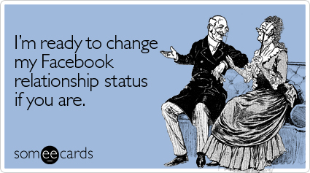
Online survey was adequate way of conducting survey
I would add the pressures of becoming “Facebook Official” and changing active relationship status to the study.

