Slide 1
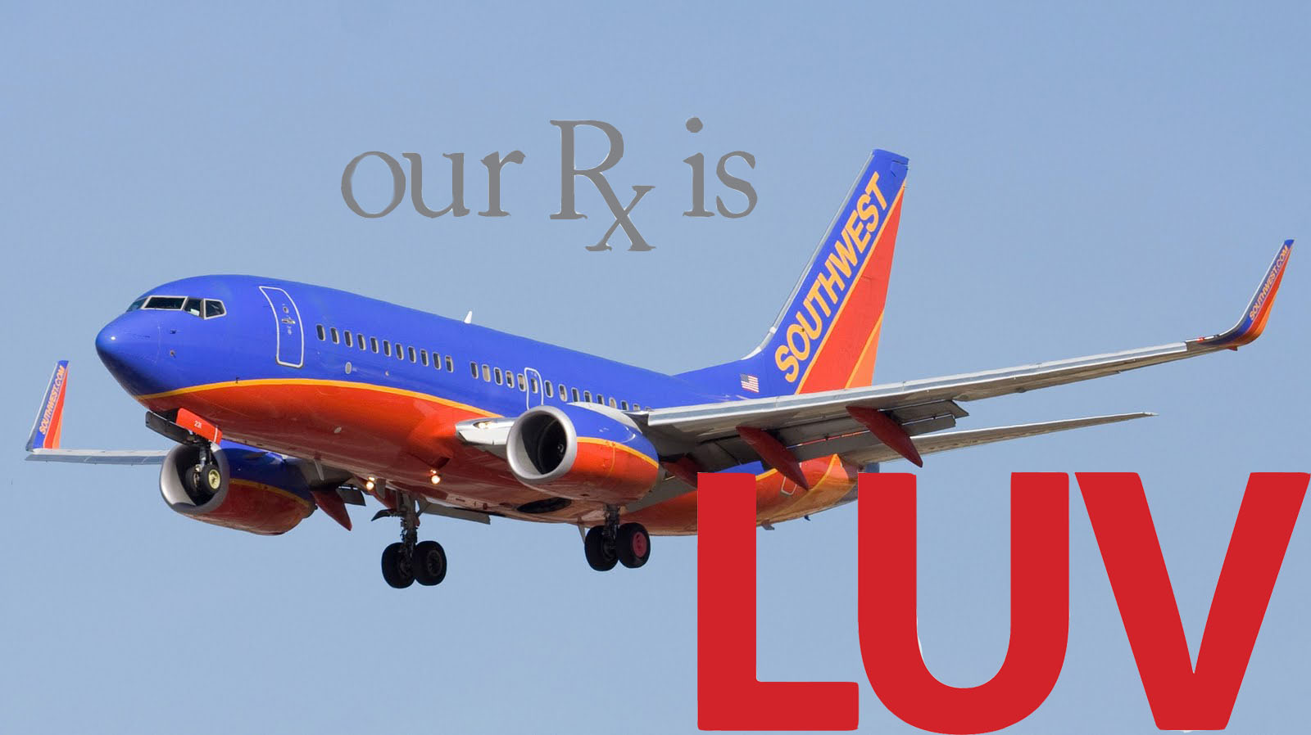
Southwest Airlines
Yulia Burvan
Anthony Connor
Karina Makarova
Christine Urban

Slide 2
History
Time flies when you’re having fun!
More than 38 years ago, Rollin King and Herb Kelleher got together and decided to start a different kind of airline. They began with one simple notion:
If you get your passengers to their destinations when they want to get there, on time, at the lowest possible fares, and make darn sure they have a good time doing it, people will fly your airline. And you know what? They were right!
What began as a small Texas airline has grown to become one of the largest airlines in America. Today, Southwest Airlines flies over 100 million passengers a year to 66 great cities all across the country, and we do it more than 3,200 times a day.

Slide 3
Southwest Airlines was founded by Rollin King and Herb Kelleher and began in 1971, servicing Dallas, Houston and San Antonio. In the mid 1980's Southwest Airlines was the first to offer the frequent miles program. Allowing the passenger to bank traveled air miles to be latter used credit for a free ticket or reduced airfare. Southwest Airlines were also the pioneers of the senior discounts, fun fares and the fun packs.
1984 marked the 4th consecutive year Southwest Airlines ranked number one in customer service. By 1998 Southwest Airlines was the 5th largest US air carrier, caring over 50 million passengers a year servicing the Northeast, Southwest and other key locations throughout the United States. In 1987, Southwest Airlines took over TranStar Airlines and in 1994, Southwest took over Morris Air. This gave Southwest a stronger edge in the market
Southwest Airlines was originally incorporated to serve three cities in Texas as Air Southwest on March 15, 1967, by Rollin King and Herb Kelleher. According to frequently-cited story, King described the concept to Kelleher over dinner by drawing on a paper napkin a triangle symbolizing the routes (Dallas, Houston, San Antonio).

Slide 4
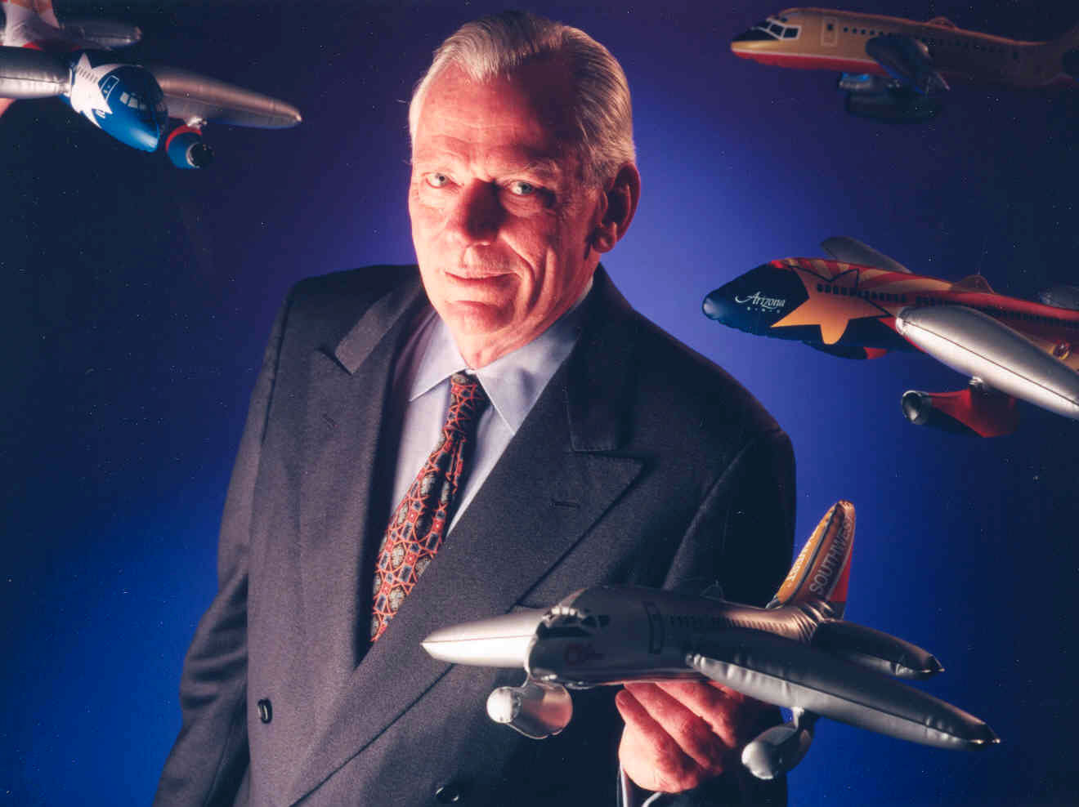
Herb kelleher

Slide 5
Milestones
1967: Company is incorporated as Air Southwest Co.
1971: Airline launches first route, connecting Dallas, Houston, and San Antonio.
1973: SWA posts first profit and begins RUSH cargo service.
1975: Southwest goes public on the American Stock Exchange.
1976: Company is renamed Southwest Airlines Co.
1977: Shares migrate to the New York Stock Exchange.
1978: Herb Kelleher becomes Southwest's outspoken new chairman.
1979: SWA flies outside Texas to New Orleans.
1981: Kelleher is named company president and CEO.
1982: SWA begins flights to West Coast.
1990: Revenues exceed $1 billion, making SWA a major airline.
1994: Morris Air and Arizona One are acquired.
1996: Online booking site is launched.
2000: SWABIZ corporate booking tool is introduced.
2005: SWA enters first ever code share arrangement, with ATA Airlines

Slide 6
Our Mission Statement
The mission of Southwest Airlines is dedication
to the highest quality of Customer Service
delivered with a sense of warmth, friendliness,
individual pride, and Company Spirit

Slide 7
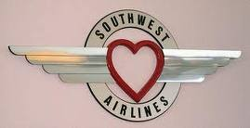
At Southwest Airlines, our Mission Statement has always governed the way we conduct our business. It highlights our desire to serve our Customers and gives us direction when we have to make service-related decisions. It is another way of saying, “we always try to do the right thing!” Our Mission Statement has also led the way to the airline industry’s best cumulative consumer satisfaction record, according to statistics accumulated and published by the U.S. Department of Transportation. That is why we are sharing it with you.
In keeping with the spirit and intent of our Mission Statement, and as evidence of our wish to continually meet the expectations of our valued Customers, Southwest wants you to have a basic understanding of how we operate. We want you to have confidence in our airline and Employees, and we want you to be aware that there are, or may be, circumstances that can have an impact on your travel plans, purchase decisions, or your overall expectations.
Foremost, we want you to know that it is never our wish to inconvenience our valued Customers. We tell our Employees we are in the Customer Service business— we just happen to provide airline transportation. It is a privilege to serve your air travel needs.
The Employees of Southwest Airlines understand our Mission and we are happy to share it, and the following information, with you, our valued Customer. Our Customer Service Commitment was designed and written in such a way as to clarify many of the most commonly questioned terms and conditions of our Contract of Carriage and provide you with insight into some of our policies and procedures.

Slide 8
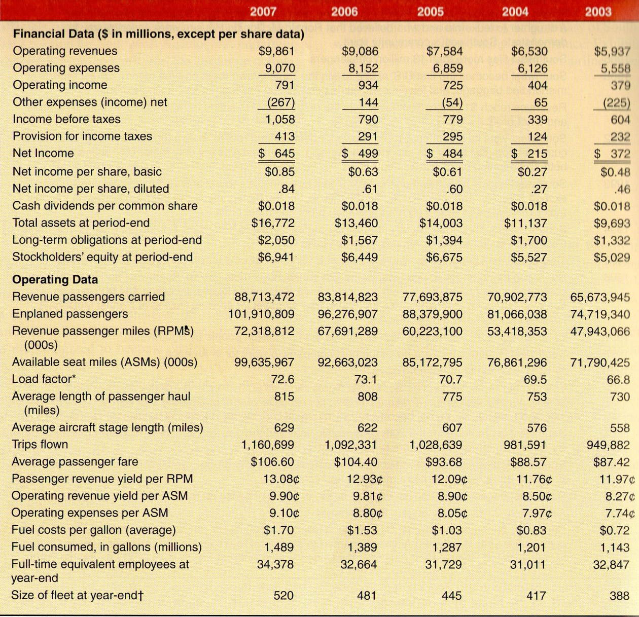
Finances
Summary of Southwest Airlines’ Financial and Operating Performance 2003 – 2007
(Year Ending December 31)
2007-12-31: $12.20 per share
(volume=4.1 million)
2010-12-05: $13.20 per share
(volume=5.3 million)

Slide 9
Always low fares
*All data represented in millions – Q4 2007
By keeping costs low for passengers, Southwest is able to stay profitable because of significantly higher volume
2007, Southwest had an average passenger fare of $106.60
For the other major U.S. airline carriers the average domestic fare was $331

Slide 10
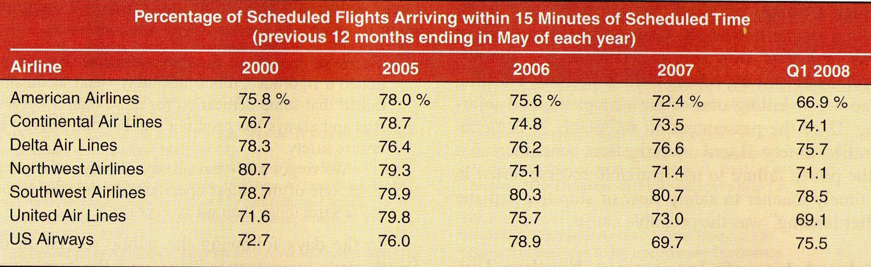
Setting the standard
One of Kelly’s strategic objectives was for Southwest “to be the safest, most efficient, and most reliable airline in the world”

Slide 11
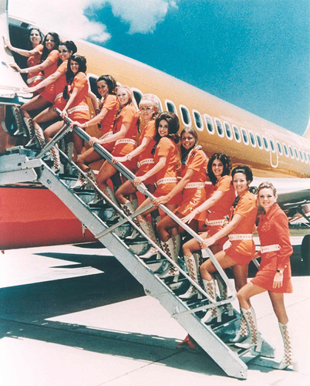
Southwest Airlines Strategy
Low-cost/low-price/no frills
“Freedom to Fly”

Slide 12
Strategy
Variety of fare options
Didn’t keep up with rival airlines’ add-on fees, stuck with an all-inclusive fare price
Shrewd practitioner of the concept of price elasticity – revenue gains from increased ticket sales would compensate for revenue erosion associate with low fares
Implemented frequent-flyer program, Rapid Rewards based on trips flown rather than mileage

Slide 13
Other strategy Elements
Gradual Expansion into new geographic markets – Southwest added one or two new cities to its route annually
Adding flights to areas where rivals were cutting back in service
Curtailing flights on marginally profitable routes where numerous seats often went unfilled and shifting planes to routes with good growth opportunities
Putting strong emphasis on safety, high-quality maintenance, and reliable operations

Slide 14
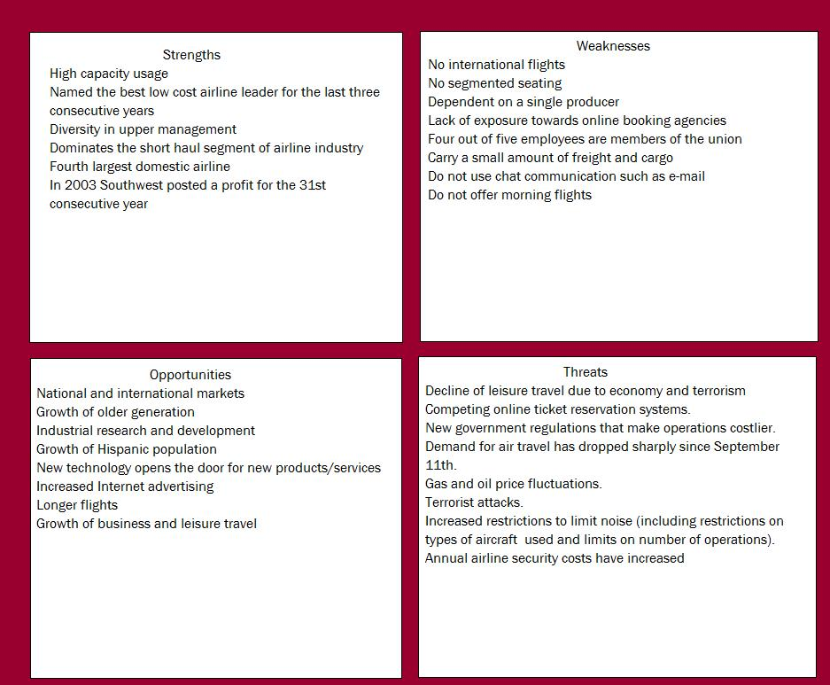
S.w.o.t. Analysis

Slide 15
CEO Timeline
1971- Lamar Muse- aggressive and self-confident airline veteran who knew business well & and who had the entrepreneurial skills to take on the challenges of building the airline from scratch and competing in the industry. In June, he raised $7 million in new capital to purchase planes and equipment and & provide cash for start up.
1978- Howard Putnam- was a group vice president of marketing services at United Airlines. He asked Kelleher to become more involved in Southwest’s day-to-day operations which allowed Kelleher to know many of the company’s personnel and observe them in action.
1981- After being asked in 1978 to take over as chairman and CEO by Southwest’s board, Herb Kelleher initially declined but then accepted in 1981 once Howard Putnam stepped down. He majored at Wesleyan University in Connecticut and graduated with a degree in philosophy and later a law degree from NYU. After several years of practicing law and getting married, Herb moved to San Antonio, TX. When he took on the role as CEO, he stayed out of his office frequently and made a point of visiting with maintenance personnel to check on how well the planes were running and to encourage his employees. He was well liked by his employees and dedicated his time every Wednesday before Thanksgiving (the busiest day for travel) to helping load bags. He also was a strong believer that employees, not customers, came first. In 2001, he stepped down as CEO but continued as chairman; He retired in 2008 but was scheduled to remain a full time Southwest employee until July 2013.

Slide 16
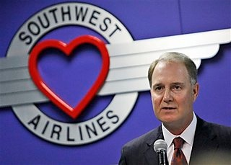
CEO Timeline
2001-2004- James Parker- was a colleague of Kelleher from an old law firm. He was the vice president of Southwest since 1986. He is credited with being Southwest’s chief labor negotiator and maintained good relations with employee unions.
2001-2008- Colleen Barratt- was originally Kelleher’s legal secretary since 1967and had been with Southwest since 1978. She served as Executive Vice President and spent much of her time on culture building, morale building, and customer service. Was the first woman appointed as president and chief operating officer of a major U.S. airline.
2004-Present- Gary C. Kelly- Since 2001 Kelly had been serving as Executive Vice President and chief financial officer. He is credited with sharpening and fine-tuning Southwest’s strategies including, expanding operations and maintaining the company’s low-cost advantage over its rivals.

Slide 17
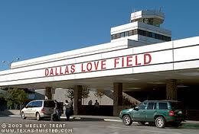
Fun Facts
Southwest once had its flight attendants dress in colorful hot pants and white knee-high boots with high heels as part of their strategy to drum up more business in their early years.
Another early strategy that Southwest implemented was giving out free alcoholic beverages to passengers during day-time flights.
Southwest was based at Dallas’s Love Field and their routes between Houston, Dallas, and San Antonio became known as the “Love Triangle.” Their planes were referred to as “love birds”, drinks were known as “love potions”, peanuts were called “love bites”, and drink coupons were known as “love stamps” all of which became an important “love” campaign that set the tone for Southwest’s approach to its customers.

Slide 18
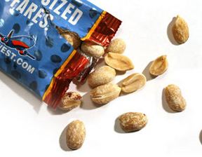
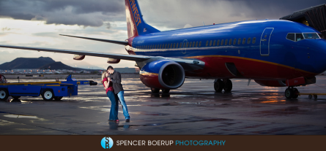

Fun Facts
In 2009 Southwest served 63.2 million cans of soda, juices, and water; 14.3 million alcoholic beverages; 14 million bags of pretzels; 90 million bags of peanuts; 17.7 million Select-A-Snacks; and 33.5 million other snacks.
In 2009, Southwest moved 182 million pounds of cargo.
The shortest daily Southwest flight is between Ft. Myers (RSW) and Orlando (MCO) (133 miles). The longest daily Southwest flight is between Providence (PVD) and Las Vegas (LAS) (2,363 miles).
Southwest has 1,164 married couples. In other words, 2,328 Southwest Employees have spouses who also work for the Company.
When calling Southwest Airlines and being put on hold, instead of the normal hold, pre-recorded message, there is a list of several different voices stating many different “fun facts” to keep their customers entertained such as, “Please remain calm and breathe deeply… And while you’re breathing deeply, think about this: Did you know that most people breath out of a different nostril every three to four hours? Just thought you’d like to know.”

Slide 19
Recommendations
In July of 2008, Southwest Airlines reported their 69th consecutive quarter of profitability, in a time when the recession was having a great affect on the U.S. Airline Industry and, the world in general. This achievement of Southwest proves their capability to rise to the top and remain there, even when all those around them are plummeting. It is evident that through superior strategy and implementation, Southwest is able to sustain their top spot in the U.S. Airline Industry; therefore any advice given to Gary Kelly should be to keep up with everything that Southwest is doing, because it works.
Southwest’s philosophy states, “We do whatever we have to do to get the job done.” This philosophy is obviously something that Southwest upholds to this day and something that Gary Kelly should never lose sight of. It is important to go to whichever lengths necessary to achieve all of the goals Southwest has.

Slide 20
Recommendations
Additionally, it is important for Gary Kelly to make sure that Southwest continues its focus on advancing in new technology, like being one of the first major airlines to introduce ticketless travel, and seeks out new opportunities to grow and expand into new markets that could be potentially profitable.
In regards to their negative publicity dealing with belated aircraft inspections and an accident in 2005, it is important for Gary Kelly to focus on preventative maintenance and proper/additional training of employees.
For the safety of its employees and customers and its reputation, Southwest cannot allow their planes to go uninspected, no matter how little the difference in dates is, and they must ensure that their pilots know how to operate every aspect of their planes in order to avoid another accident like the one from 2005 where the pilot failed to use available reverse thrust in a timely manner to safely slow down the plane in a snow storm.

Slide 21
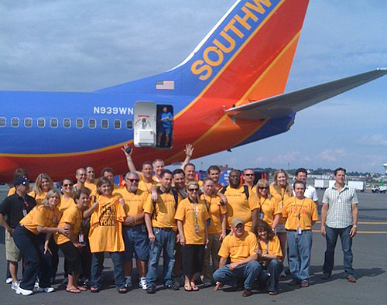

Thank You for Flying…

